Slide 1
Presentation on Oligopoly Market : Luxury Car Industry
1
BY
MAYUKH PAUL
BSC ECONOMICS 1ST YEAR 2ND SEM
MICROECONOMICS
SISTER NIVEDITA UNIVERSITY, KOLKATA
(SNUK)

Slide 2
SLIDE PLANS
2
INTRODUCTION : OLIGPOLY MARKET
LUXURY CAR INDUSTRY (AUTOMOBILE)
LUXURY CAR INDUSTRY SALES IN INDIA (2012-22)
LUXURY CAR PRODUCTION(2007-21)
TECHNICAL REGULATIONS & STANDARDIZATION
CONCLUSION

Slide 3

INTRODUCTION : OLIGPOLY MARKET
3
A large number of firm in the industry but in the industry is dominated by small firm of very larger producer.
For e.g. Google Android and Apple IOS
Potential for collision in order to raise prices and realize a higher economic profit.
Few sellers and large number of buyers.
Homogenous or differentiate product.
High barriers to new entry.
1

Slide 4




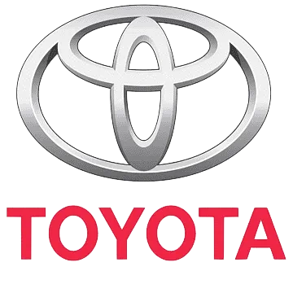
LUXURY CAR INDUSTRY (AUTOMOBILE)
4
Automobiles Industry is considered an Oligopoly market because it has considerable boundaries to enter it, it relies on brand loyalty and image to make sales, and it is dominated by four major automobile companies.
And that four companies are Toyota, Mercedes-Benz, Volkswagen, BMV and Audi. This ensures not only the companies' survival but also their mutual ascendance and usually massive profits.
BMW
2

Slide 5
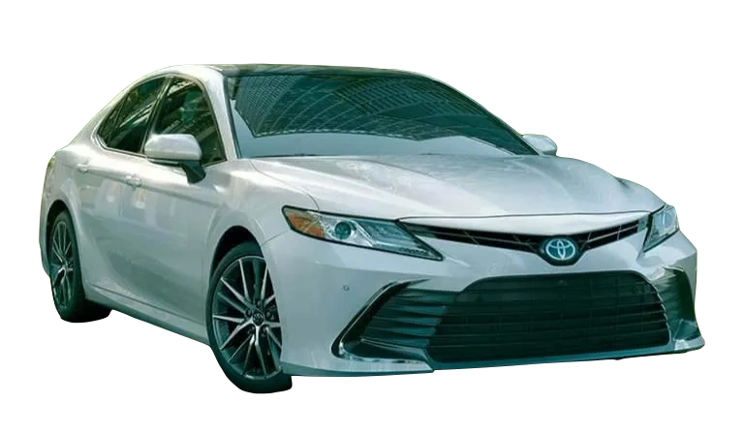
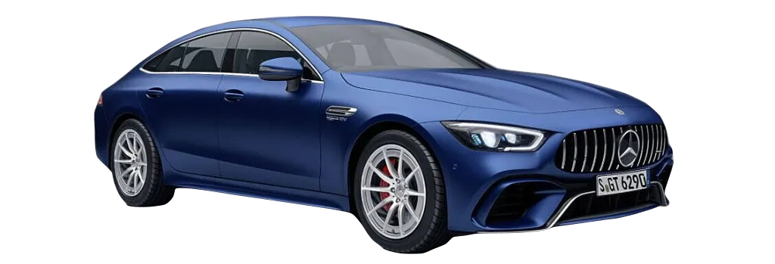
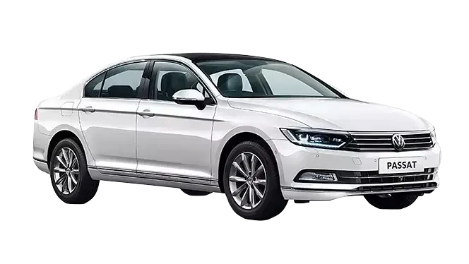
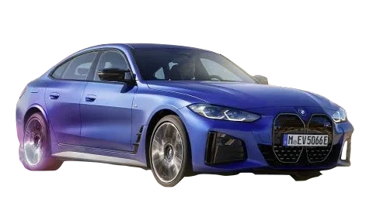
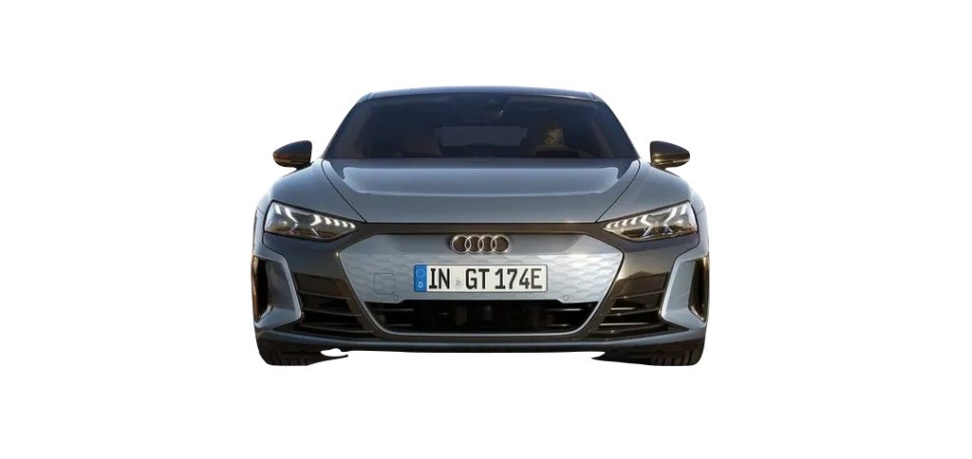
5
LUXURY CAR INDUSTRY SALES IN INDIA (2012-22)
3

Slide 6
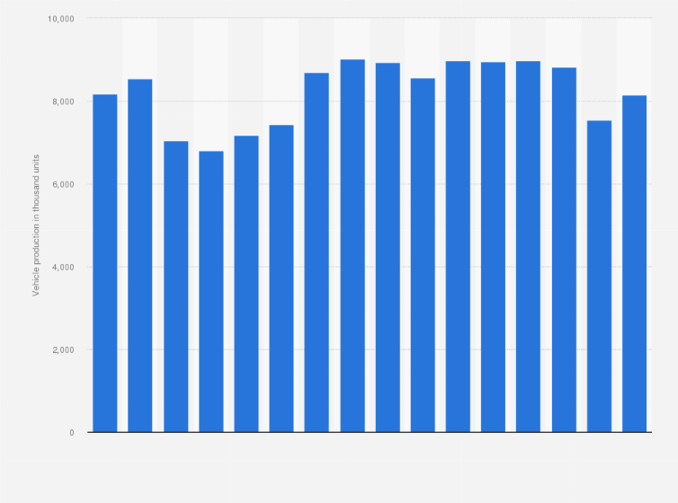
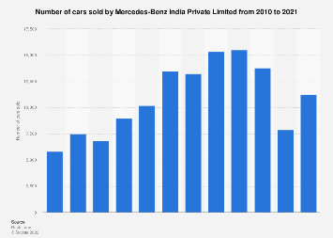
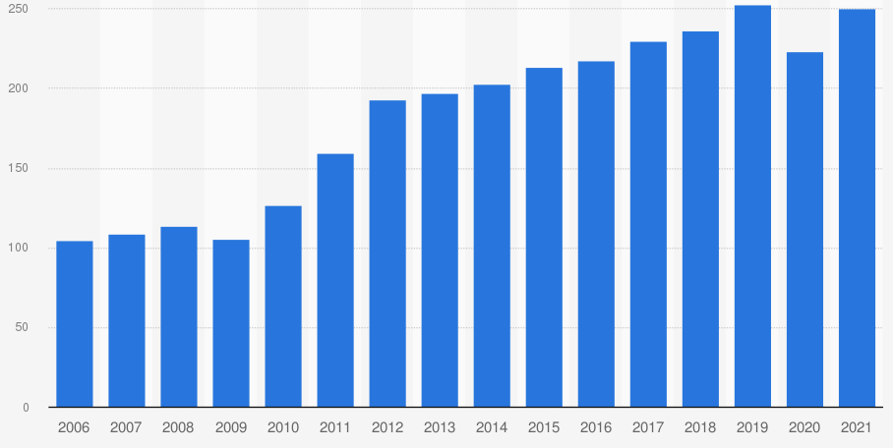
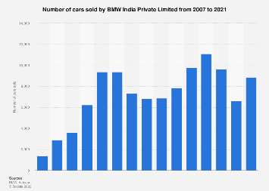
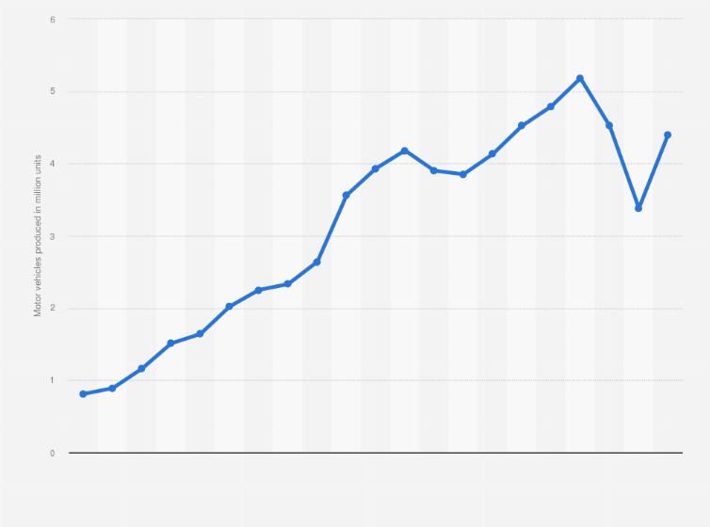
LUXURY CAR PRODUCTION(2007-21)
6
TOYOTA
MERCEDES-BENZ
VOLKSWAGEN
BMV
AUDI(2005-21)

Slide 7
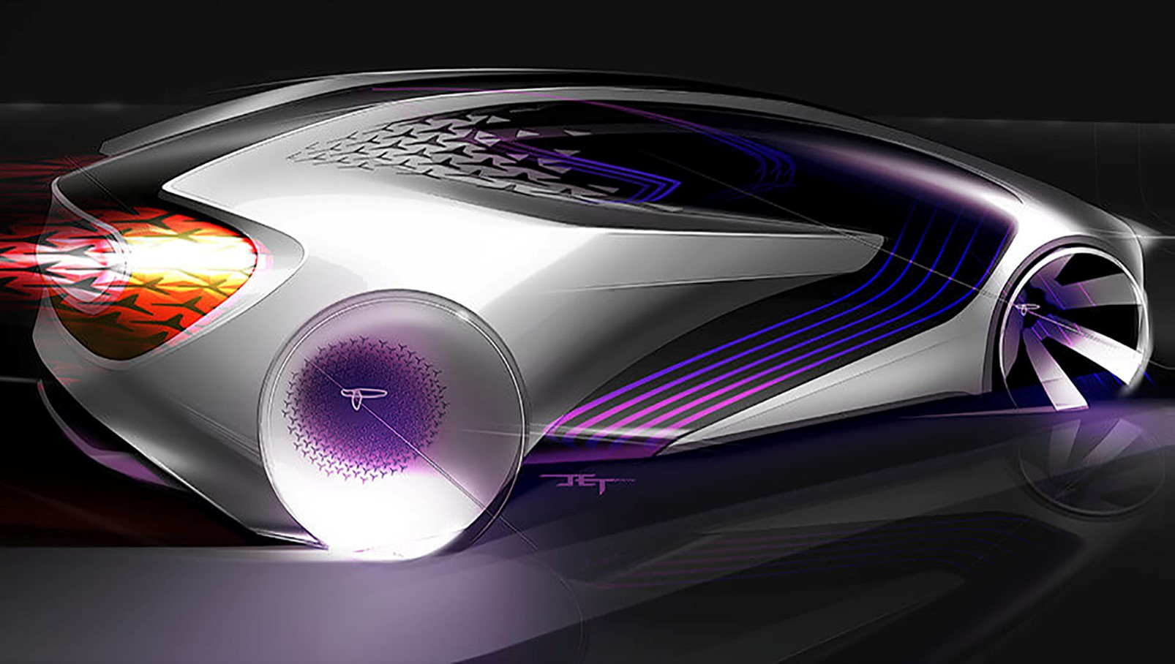
TECHNICAL REGULATIONS & STANDARDIZATION
7
CURRENT AFFAIRS
Automotive Research Association of India (ARAI)
1) Government approved test agency to carry out mandatory certification testing
2) Provides technical expertise in R&D, test, certification, homologation and framing of vehicles regulations.
3) ARAI has 6 GR groups (subsidiary technical bodies of WP.29) are:
4) GRPE (India) : Working Party on Pollution and Energy
5) GRSG (India) : Working Party on General Safety Provisions
6) GRRF (India) : Working Party on Brakes and Running Gear
7) GRB (India) : Working Party on Noise
8) GRSP (India) : Working Party on Passive Safety
9) Published/drafted several standards that are related to electric/smart mobility

Slide 8
CONCLUSION
8
Industry across countries will have to meet challenges of newer technologies, alternative fuel and affordability of automobiles by people at large through constructive cooperation. The earlier we are able to achieve this the better it would be for the world performance.
As the Indian automobile industry aims to be among the world’s top three in automobile manufacturing by 2026, e-mobility and ITS by far are the greatest opportunity
Automotive players must explore ways to reduce battery cost, charging time and to increase driving range.
7

Slide 9
REFERNCES
9
https://www.team-bhp.com/news/sales-trends-luxury-cars-india-2007-2019
https://www.team-bhp.com/forum/attachments/indian-car-scene/2108547d1610688954-2020-report-card-annual-indian-car-sales-analysis-screenshot_1.png
https://www.slideshare.net/yugeshkumardubey/automobile-sector-2691513
https://www.thehindubusinessline.com/companies/govt-making-favourable-policies-for-auto-sector/article24874607.ece

Slide 10

10

